Slide 1

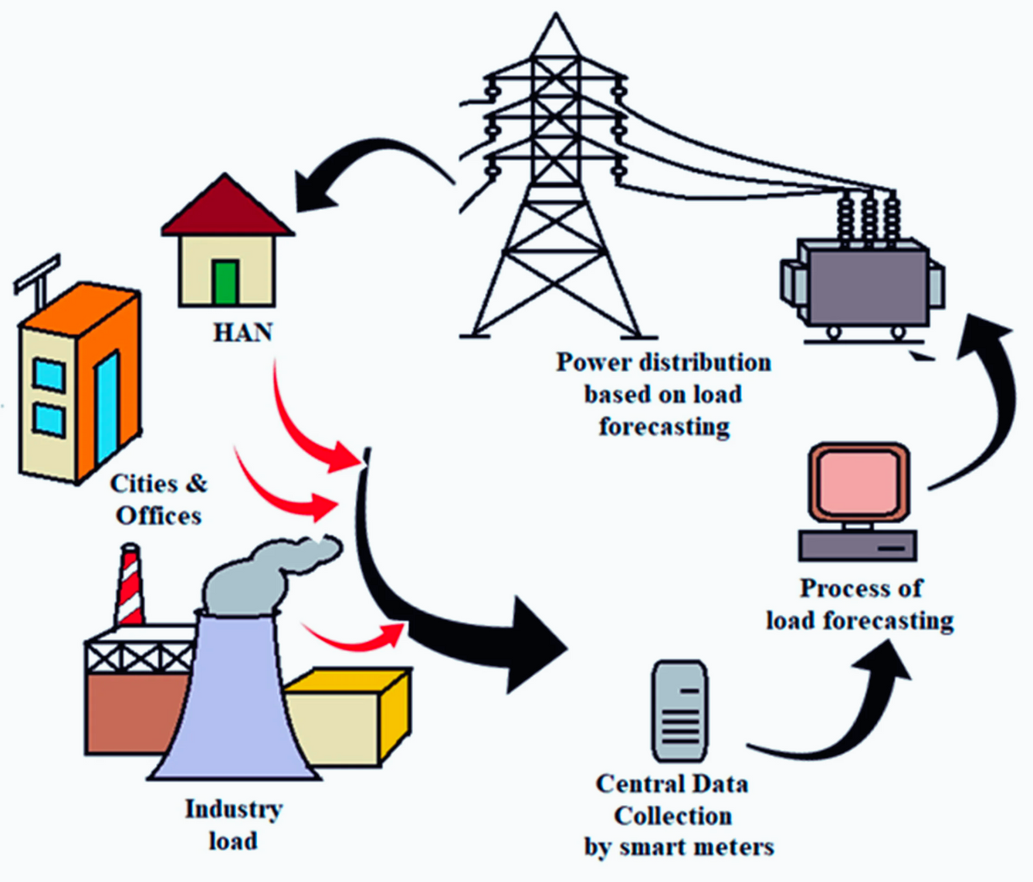

Modeling and Predicting Household Energy Consumption
Presented By:
Chandan Pandit (202418043)
Vivek Gautam (202418053)

Slide 2
Introduction
What is load forecasting?
Load forecasting is predicting future electricity demand using past consumption patterns, weather, and time-based factors.
It helps understand how much power will be needed in the next hour, day, or season.
Why is forecasting important?
Ensures reliable and uninterrupted electricity supply
Prevents overloading of transformers and feeders
Helps in planning power generation and distribution
Reduces outages and improves voltage quality
Supports renewable energy integration and cost-efficient grid operation
Studio Shodwe

Slide 3
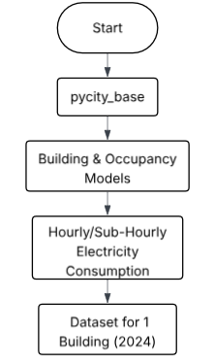
Data Generation Framework
pyCity Ecosystem: Open-source framework for urban energy modeling.
Purpose: Simulates and forecasts electricity for buildings and districts.
pycity_base: Core library for building-level modeling and hourly/sub-hourly consumption generation.
Generated synthetic hourly electricity data for a single building (2024) for forecasting experiments.
Project.

Slide 4
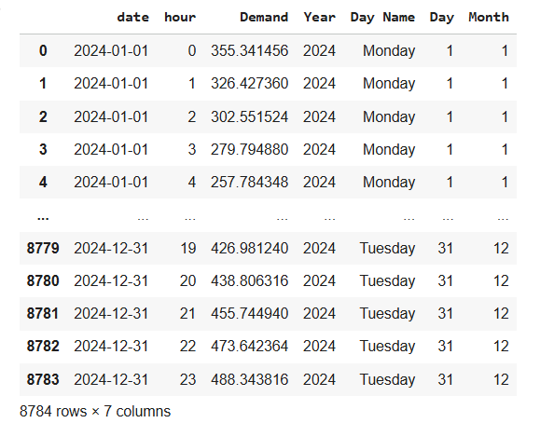

Dataset Overview/Preprocessing
Dataset Overview
Generated using pycity_base for a single building.
Contains hourly synthetic electricity consumption for the year 2024 (366 × 24 = 8784 records).
Example: first 5 rows and last 5 rows of the dataset shown in the table.
Preprocessing Performed
Added lag features (previous hour, previous day values).
Added rolling mean features to capture short-term and long-term trends.
Extracted time-based features such as month, day, hour.
Applied label encoding for categorical fields.
These preprocessing steps prepare the synthetic dataset for building and testing forecasting models.

Slide 5
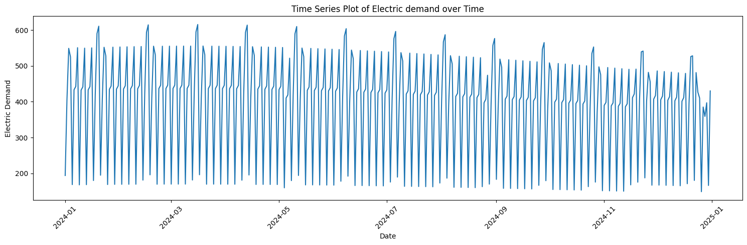
Exploratory Analysis
Time-Series Plot
Shows clear daily repeating patterns, indicating strong hourly cyclic behavior.
Peaks and troughs occur consistently each day → demand follows a stable, predictable pattern.
No sudden spikes or anomalies → synthetic data is clean and well-behaved.
A gradual change in amplitude over months reflects mild seasonal variation.

Slide 6
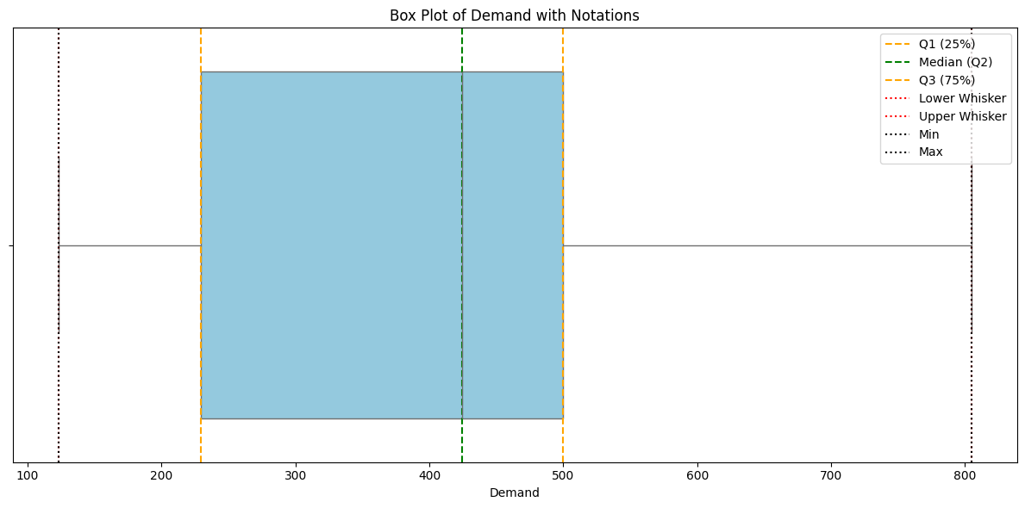
Exploratory Analysis
Box Plot :
Q1 = 229.54
Median = 424.70
Q3 = 500.01 → most values lie in a moderate demand range.
IQR (270.47) indicates moderate variability in load.
Lower Whisker = 123.06, Upper Whisker = 804.87 → no extreme fluctuations.
No outliers detected → synthetic load is smooth and statistically stable.
Distribution is slightly right-skewed (higher spread above median).

Slide 7
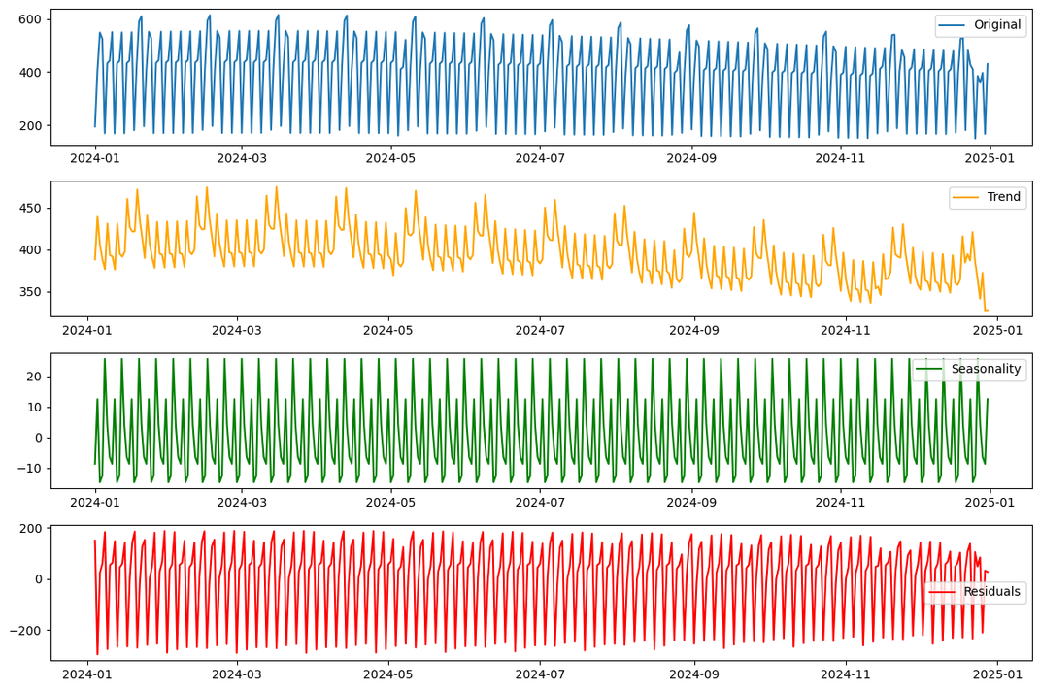
TimeSeries Decomposition:
Time Series Decomposition is a technique that breaks a time-series into its main components to better understand the data pattern over time.
Actual: The original observed time series data.
Trend: The long-term direction or movement in the data, indicating increasing or decreasing patterns over time.
Seasonal: Repeating short-term cycles or periodic fluctuations (e.g., daily, weekly, yearly).
Residual: The random noise or irregular component left after removing trend and seasonality
Project.

Slide 8
Augmented Dickey-Fuller (ADF) Test
What is ADF Test (Augmented Dickey–Fuller Test)
The ADF test is a statistical test used to check whether a time series is stationary or non-stationary.
Why We Use It
We use the ADF test to: Check if a series stationary or not
Decide whether differencing is required before applying models like ARIMA
Project.
Null & Alternative Hypothesis
Null Hypothesis (H₀): it is non-stationary
Alternative Hypothesis (H₁): it is stationary
Condition to Reject or Accept H₀
Using p-value (most common):
If p-value < 0.05 → Reject H₀ → Series is stationary
If p-value ≥ 0.05 → Fail to reject H₀ → Series is non-stationary
Result
ADF Statistic: -18.413410
p-value: 0.000000
Conclusion: Reject null hypothesis → Series is stationary

Slide 9
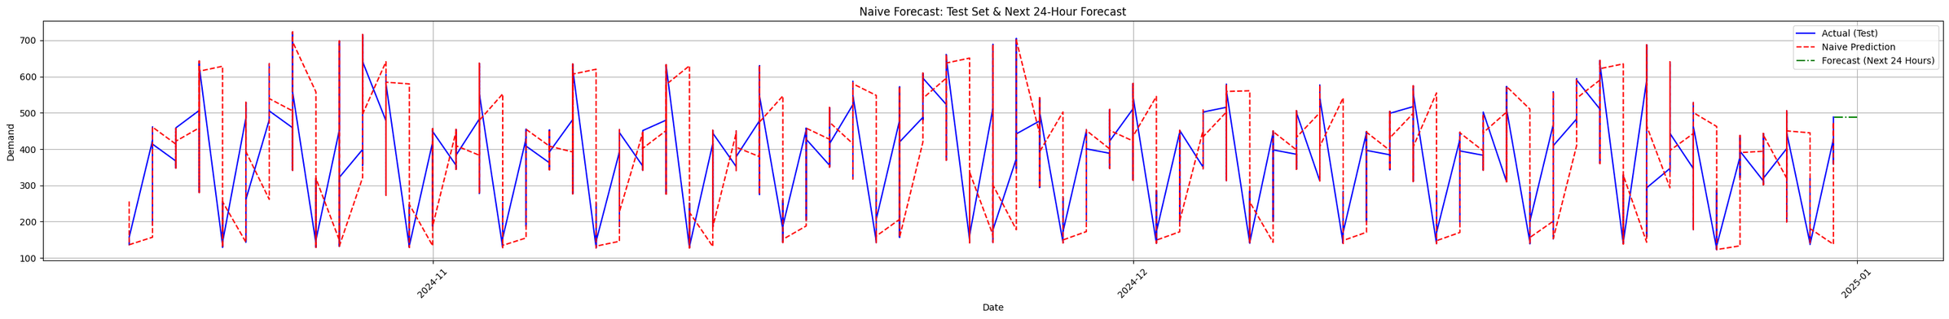
NAIVE FORECASTING
Naive Bayes for Time Series Forecasting
A simple probabilistic model that predicts future values using past data patterns.
Assumes independent features, making it fast and useful as a baseline forecaster.
Naive Forecasting — Model Evaluation Results
Train Set
MAE: 49.4822
MSE: 9092.7567
RMSE: 95.3559
R²: 0.7022
Validation Set
MAE: 45.4711
MSE: 7818.9425
RMSE: 88.4248
R²: 0.6971
Test Set
MAE: 43.1560
MSE: 6688.6546
RMSE: 81.7842
R²: 0.7074
Studio Shodwe
Project.

Slide 10
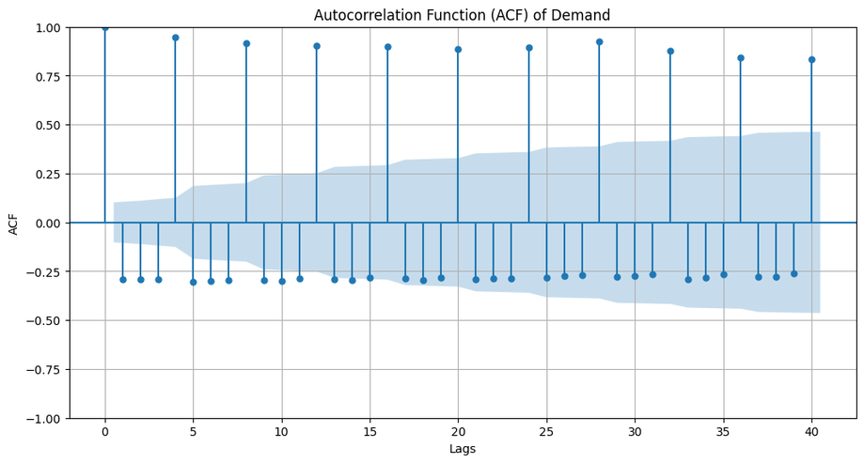
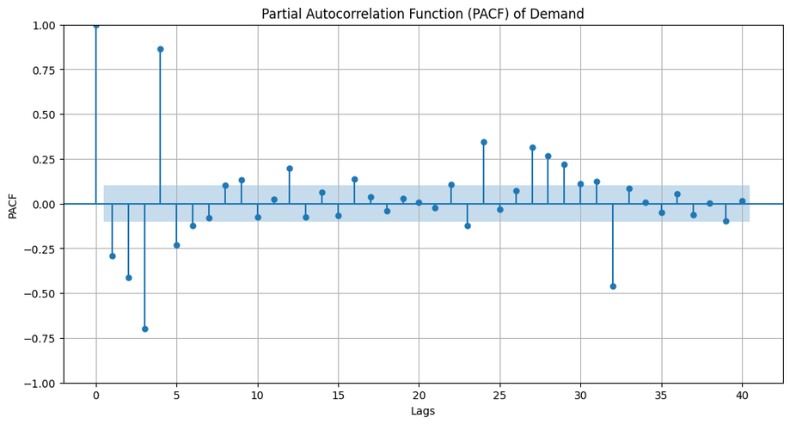
Autocorrelation and Partial Autocorrelation
ACF (Autocorrelation Function)
ACF measures how a time-series is correlated with its own past values at different lags.
It helps identify patterns like trend, seasonality, and how many past values influence the current value.
PACF (Partial Autocorrelation Function)
PACF measures the direct relationship between a time-series and its past values while removing the effect of intermediate lags.
It shows how much each lag contributes independently.
Use in Forecasting
ACF helps choose MA (moving average) terms in ARIMA.
PACF helps choose AR (autoregressive) terms in ARIMA.
Studio Shodwe
Project.

Slide 11
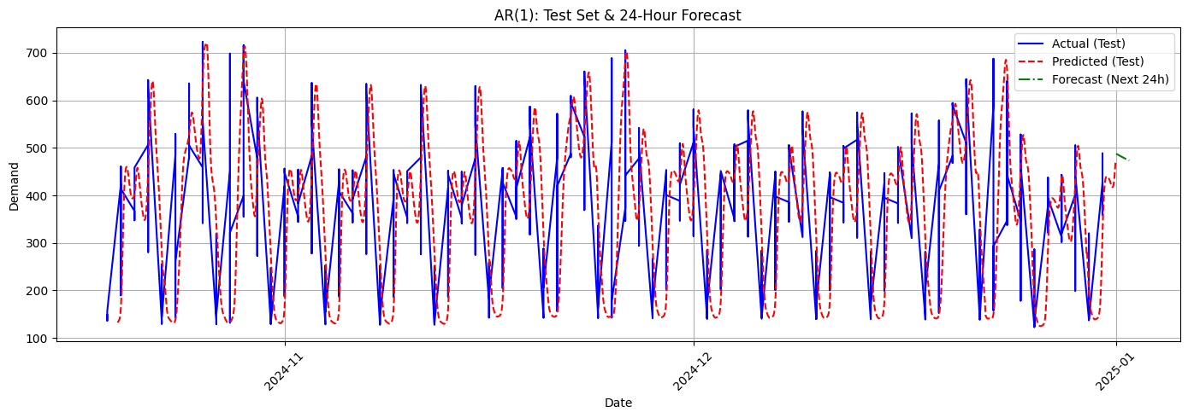
AR(1)MODEL
AR Model (Autoregressive Model)
An AR model predicts the future value of a time series using a linear combination of its past values.
It assumes that the current value depends on previous observations plus some random error.
Example: AR(1) uses the past 1 time steps to forecast the next value
AR(1) Model — Evaluation Results
Train Set
MAE: 16.4393
MSE: 442.78
RMSE: 21.0423
R²: 0.9855
Validation Set
MAE: 15.1612
MSE: 378.24
RMSE: 19.4485
R²: 0.9852
Test Set
MAE: 14.0015
MSE: 322.63
RMSE: 17.9624
R²: 0.9859

Slide 12
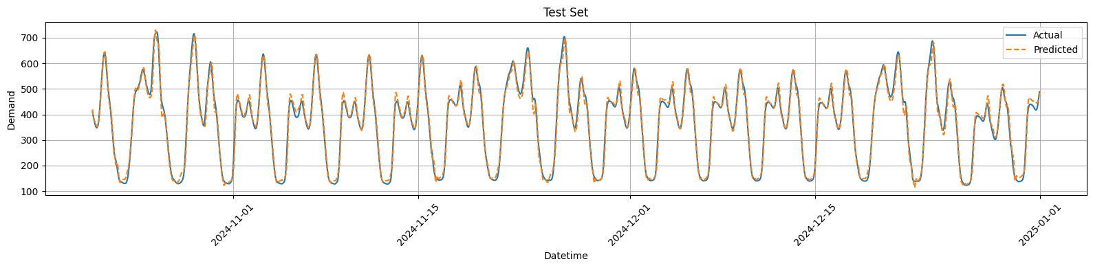
VANILLA RNN MODEL
Vanilla RNN (Recurrent Neural Network)
A Vanilla RNN is the simplest form of a recurrent neural network that processes sequence data by using its previous hidden state and current input to generate the next output.It learns patterns over time by retaining information from earlier time steps.
Train Set Metrics:
MSE: 378.1258
MAE: 14.4468
R²: 0.9875
Validation Set Metrics:
MSE: 300.7877
MAE: 13.2164
R²: 0.9882
Test Set Metrics:
MSE: 300.7407
MAE: 13.5974
R²: 0.9870

Slide 13
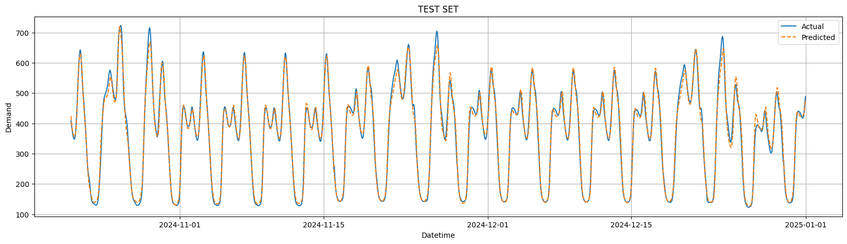
LSTM MODEL
LSTM
An LSTM is a type of recurrent neural network (RNN) that processes a sequence in one direction — forward in time. It uses memory cells along with input, forget, and output gates to store and update information, allowing the model to learn long-term dependencies and patterns in sequential or time-series data.
Train Set Metrics:
MSE: 192.3571
MAE: 10.6868
R²: 0.9937
Validation Set Metrics:
MSE: 236.4821
MAE: 12.1057
R²: 0.9908
Test Set Metrics:
MSE: 421.5775
MAE: 15.8230
R²: 0.9818
Studio Shodwe
Project.

Slide 14
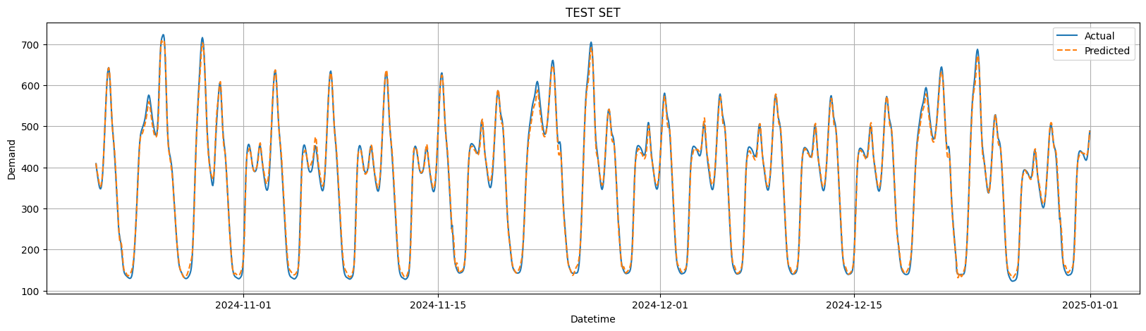
GRU MODEL
GRU
A GRU is a type of RNN that processes sequences using reset and update gates to control information flow. It captures long-term dependencies with fewer parameters than LSTM, making it faster and efficient for time-series forecasting.
Train Set Metrics:
MSE: 124.0355
MAE: 8.4190
R²: 0.9959
Validation Set Metrics:
MSE: 112.2594
MAE: 8.4652
R²: 0.9956
Test Set Metrics:
MSE: 112.9609
MAE: 8.5926
R²: 0.9951

Slide 15

Conclusions
Electrical demand shows strong seasonal and weekly cycles
ADF confirms stationarity
ACF/PACF suggests AR(1) behavior
RNN, LSTM & GRU deliver high accuracy
GRU most efficient model
Very suitable for short-term load forecasting
Studio Shodwe
Project.

Slide 16
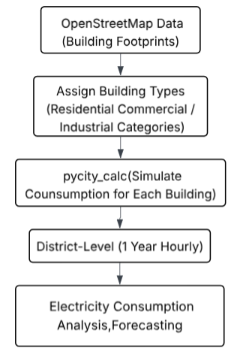
Future Work Using pycity_calc
Next major step: Use pycity_calc for full-scale simulations
Planned work:
Generate district-level synthetic load data
Use Gandhinagar buildings (via OpenStreetMap)
Assign building types (residential/commercial/industrial)
Simulate hourly demand for the entire district for 1 year
Why this is powerful:
Enables large-scale forecasting models
Helps analyze EV charging demand, solar adoption, peak load
Supports research in smart grids & urban energy planning
Project.

Slide 17

THANK YOU

